Slide 1
The Big Data Ecosystem at LinkedIn
Jay Kreps

Slide 2
Me
Background in data not infrastructure
LinkedIn’s SNA team
Original co-author of some LinkedIn open source projects (Voldemort, Azkaban, Kafka)

Slide 3
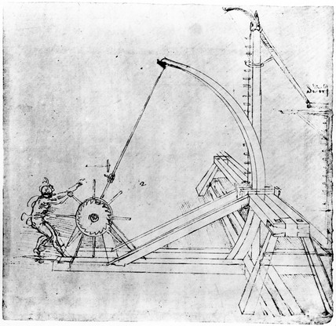
This Talk
We are in a renaissance of data infrastructure.
How do all these pieces fit together?

Slide 4
Why the current obsession with “Big Data”?

Slide 5

The goal of modern data infrastructure is to make many small computers act like one big one.

Slide 6
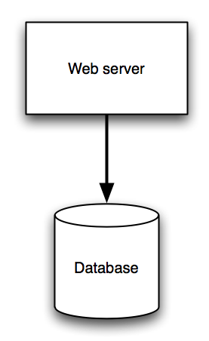
The Old Picture

Slide 7
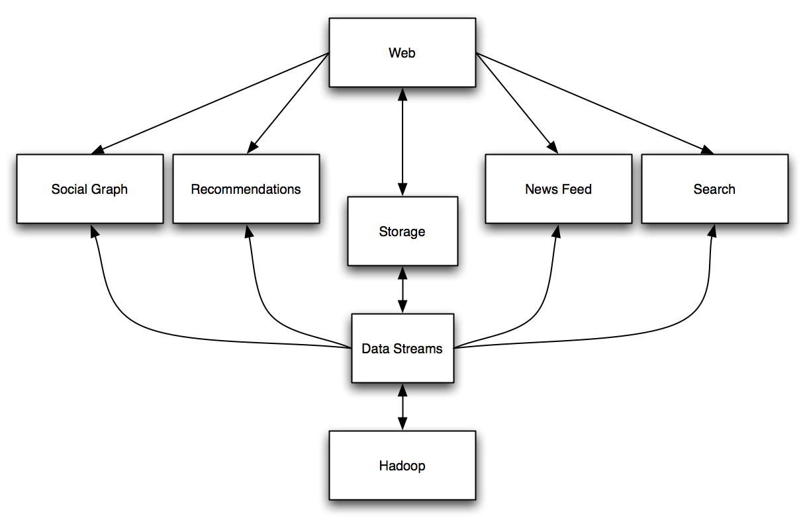
The New Picture

Slide 8
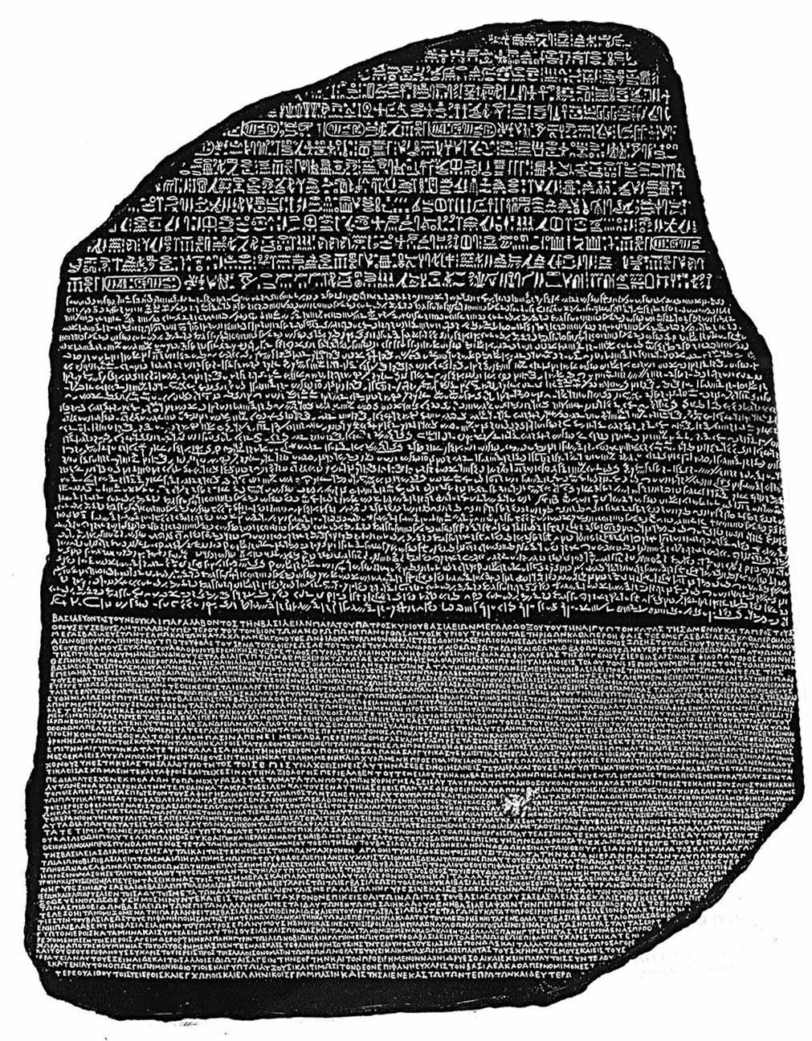
Polyglot persistence?

Slide 9

Infrastructure Icebergs
90k lines of tooling and monitoring, 30k lines of logic
Dedicated engineers, operations
Training
First three nines come from operations

Slide 10
This is (still) a very immature space. Which systems should we have?
Notes:
Good news for users, bad news for distributed systems nerds
Filesystems take a decade to mature. Don’t expect this will be easier.

Slide 11
Infrastructure is sculpted by applications and constraints
Projects are defined by trade-offs

Slide 12
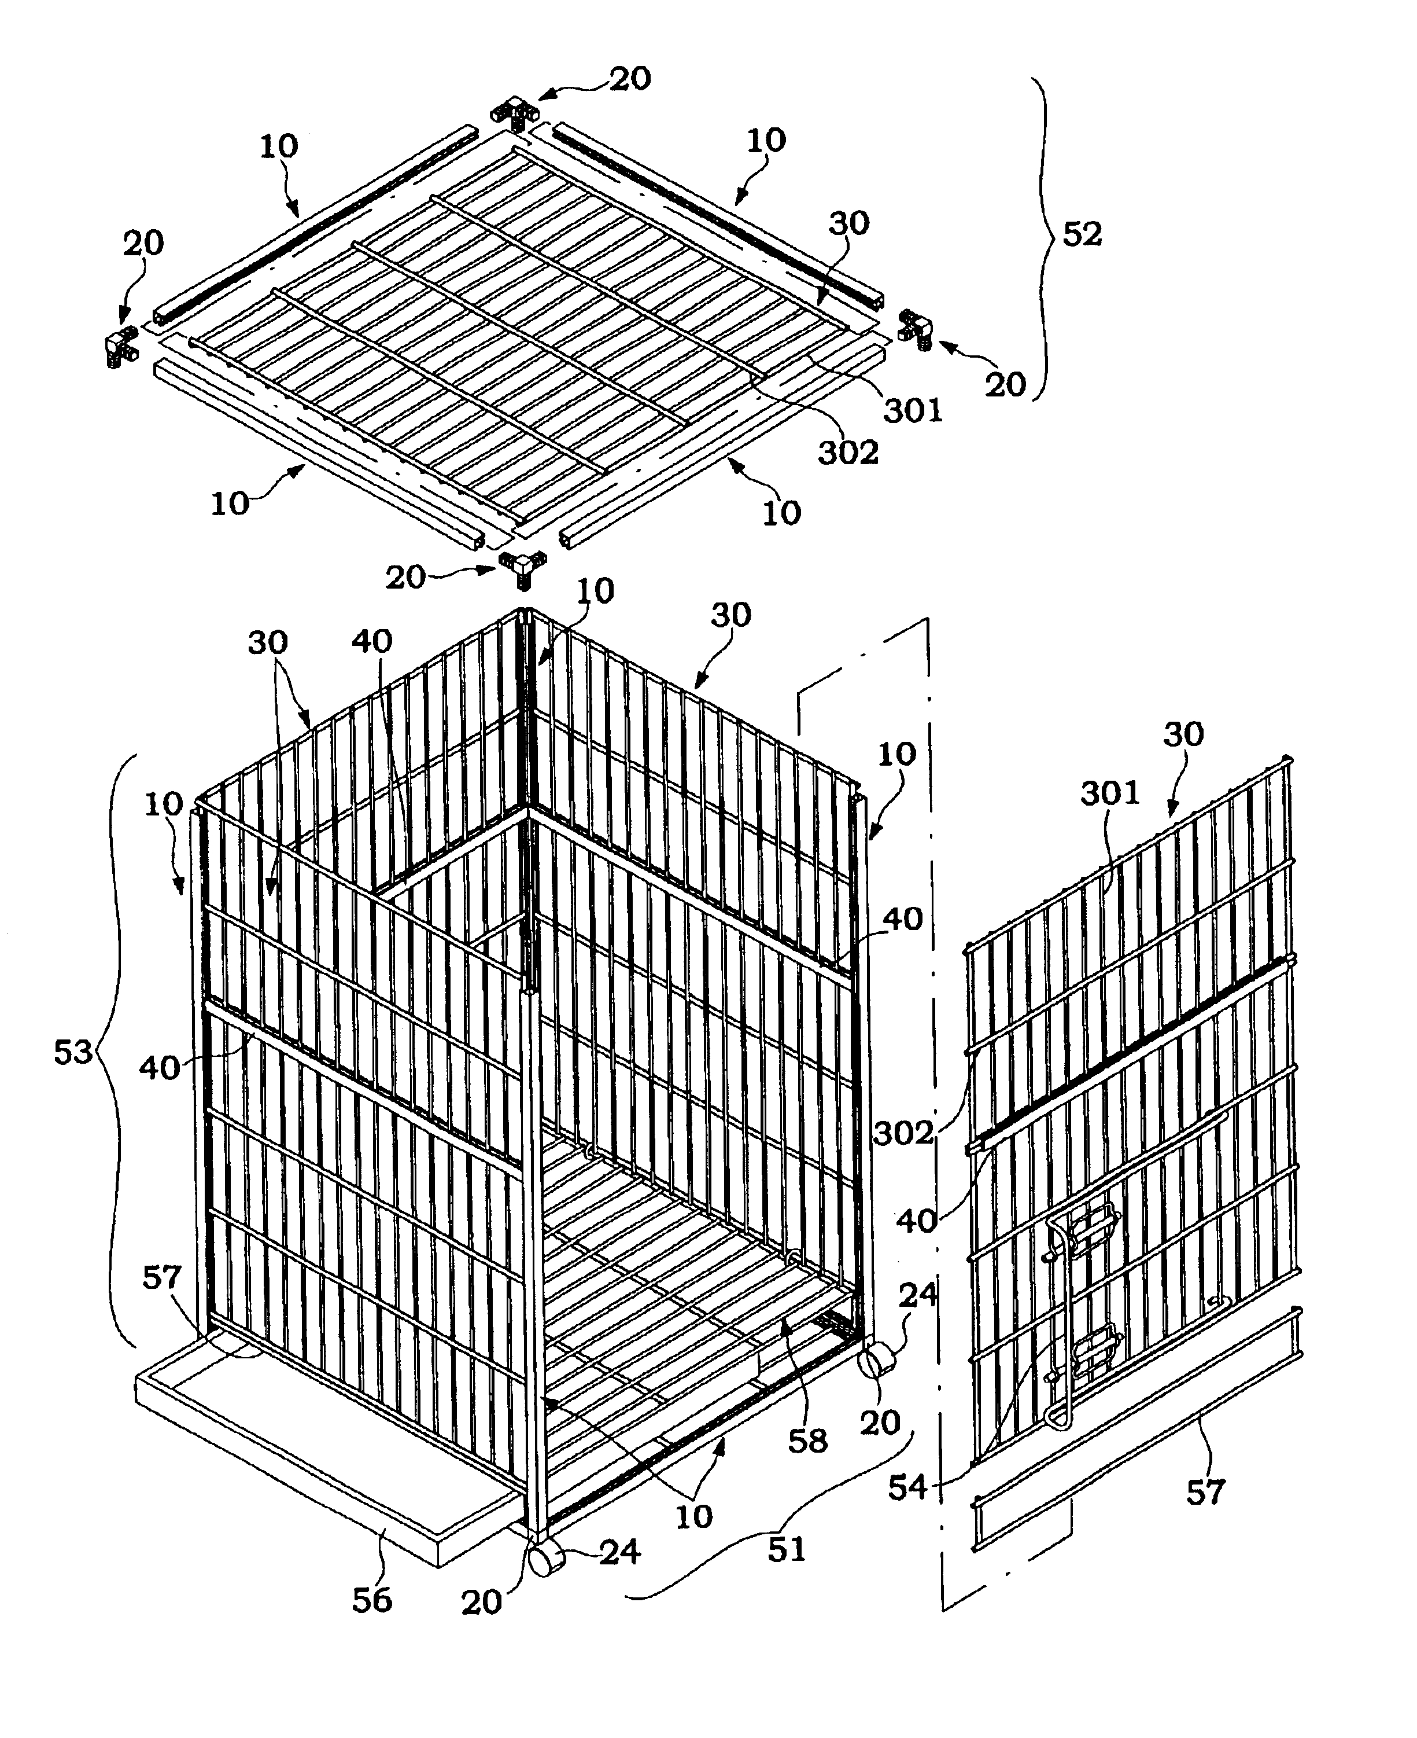
Constraints
Hardware
  Jeff Dean: Numbers everyone should know
  David Patterson: Latency lags bandwidth
  $$$
Other
  Path dependence
  Complexity
  Resources

Slide 13
Applications

Slide 14
Common categories of non-CRUD
Recommendations & Matching
Graphs
Search
Data Normalization
News feed
Analysis & Monitoring

Slide 15
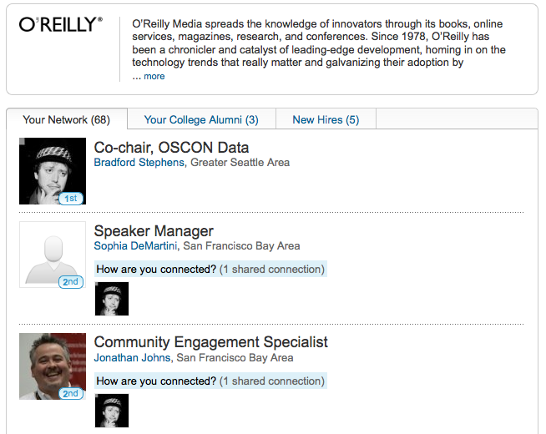
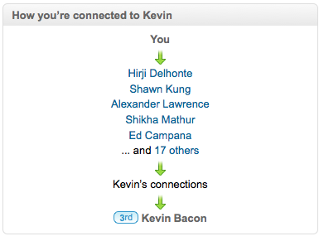
Social Graph

Slide 16
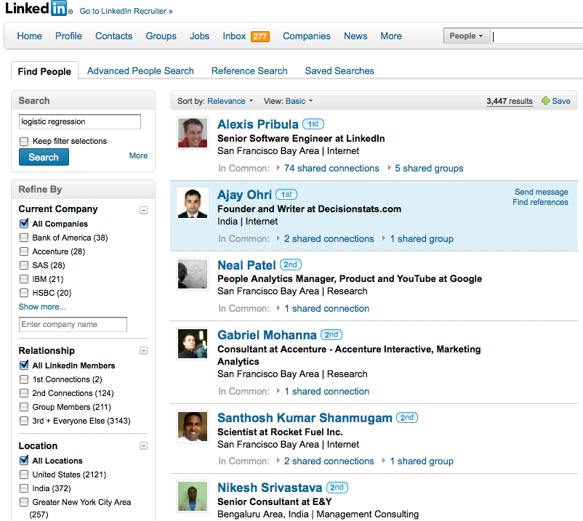
Search

Slide 17
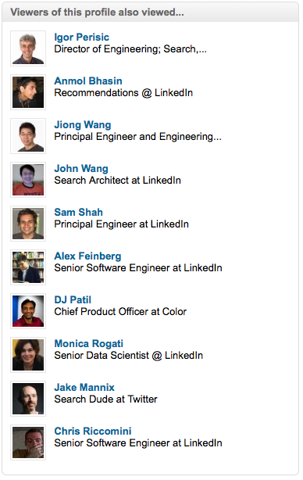
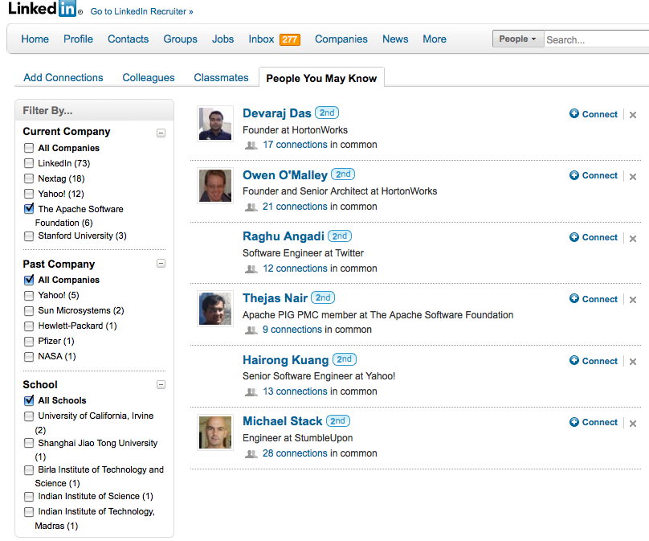
Recommendations: People

Slide 18
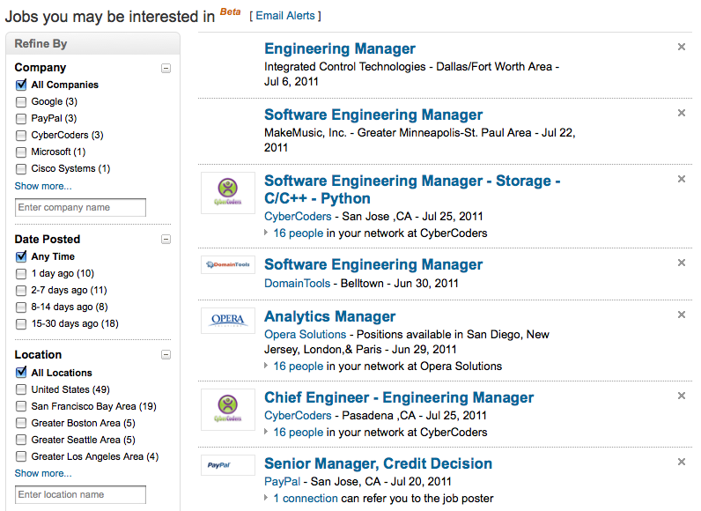
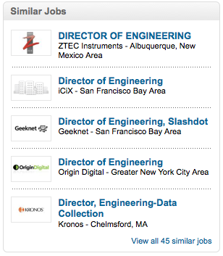
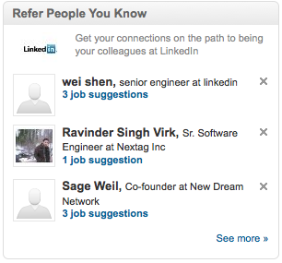
Recommendations: Jobs

Slide 19
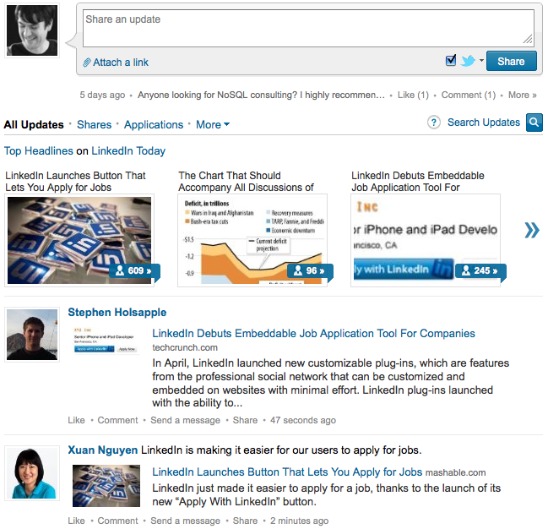
Recommendations: Newsfeed

Slide 20
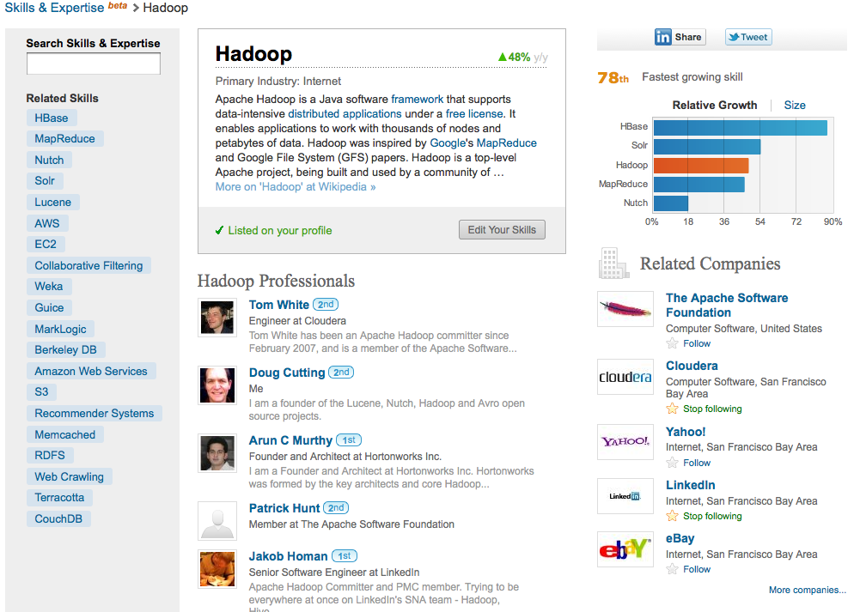
Data Normalization

Slide 21
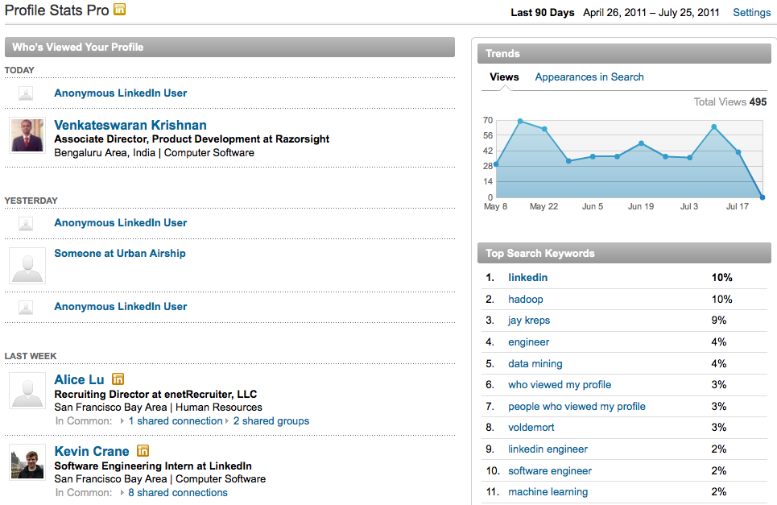
Analytics

Slide 22
Infrastructure
Search
  Lucene
  Bobo (facets), Zoie (real-time indexing), Sensei (distribution)
Social Graph
Storage
  Oracle
  Voldemort
  Espresso
Streams
  Databus
  Kafka
Offline
  Hadoop & friends (Pig, Hive, Azkaban, etc)

Slide 23
Three Major Paradigms
Request/Response
  Search
  Social Graph
  Storage
Streams
  Kafka
Batch
  Hadoop

Slide 24
Most features are multi-paradigm

Slide 25
Request/Response
Search
Social Graph
Storage
  Voldemort
  Espresso

Slide 26
Request/Response Patterns
Broker, scatter-gather
  Storage systems: only
Partitioning strategy
Latency oriented

Slide 27
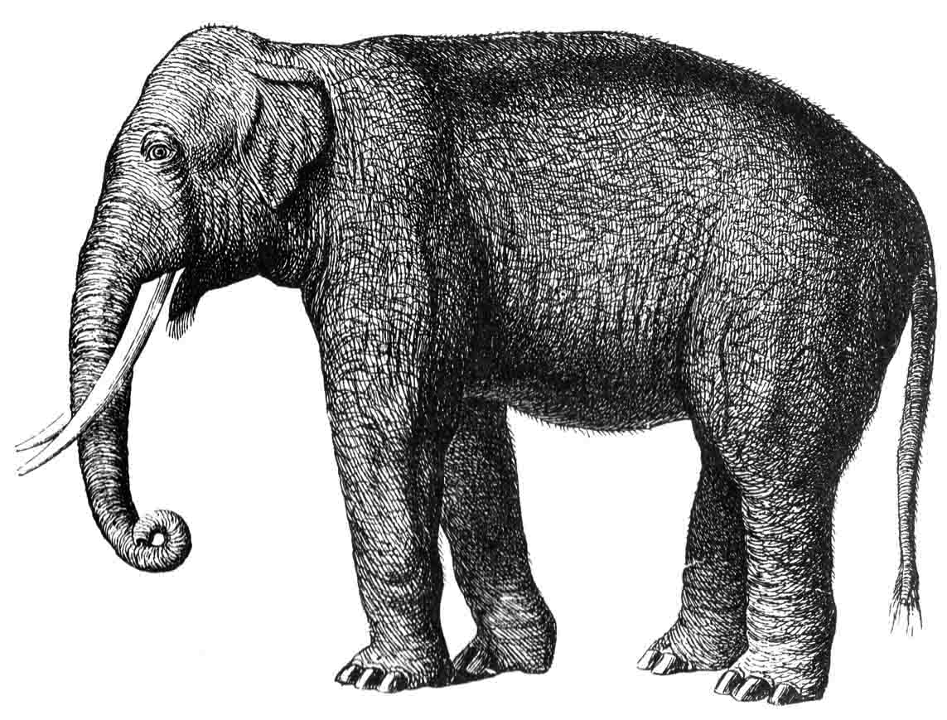
Batch: Hadoop
Uses
  Ad hoc
  Production batch
Ecosystem
    Hive, Pig
    Azkaban (workflow)
    Avro data
    Data in: Kafka
    Data out: Voldemort, Kafka

Slide 28
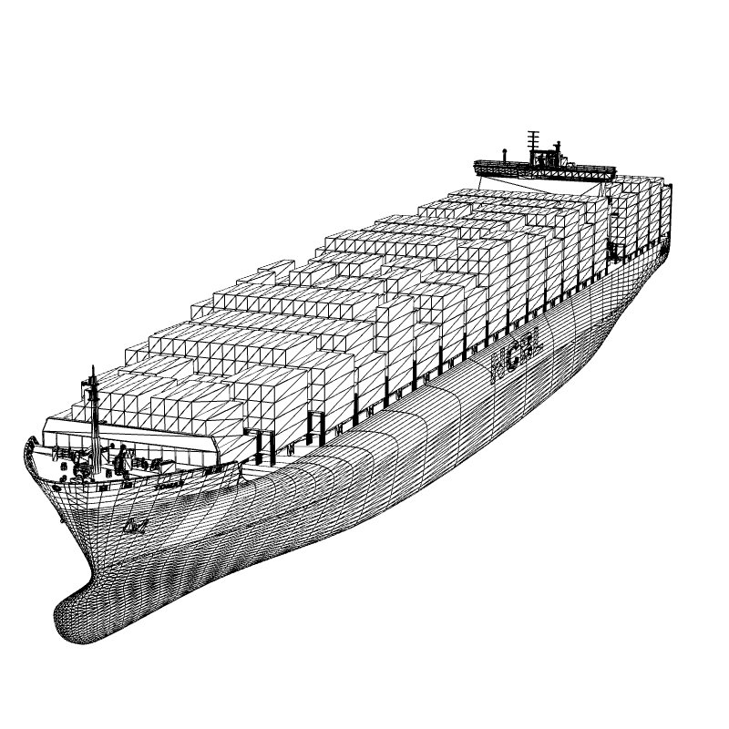
Why do batch if you have real-time?
Batch advantages
  Safety
  Easy
  Throughput
  Simplicity
  Economics
Tricky bit: engineering the data cycle

Slide 29
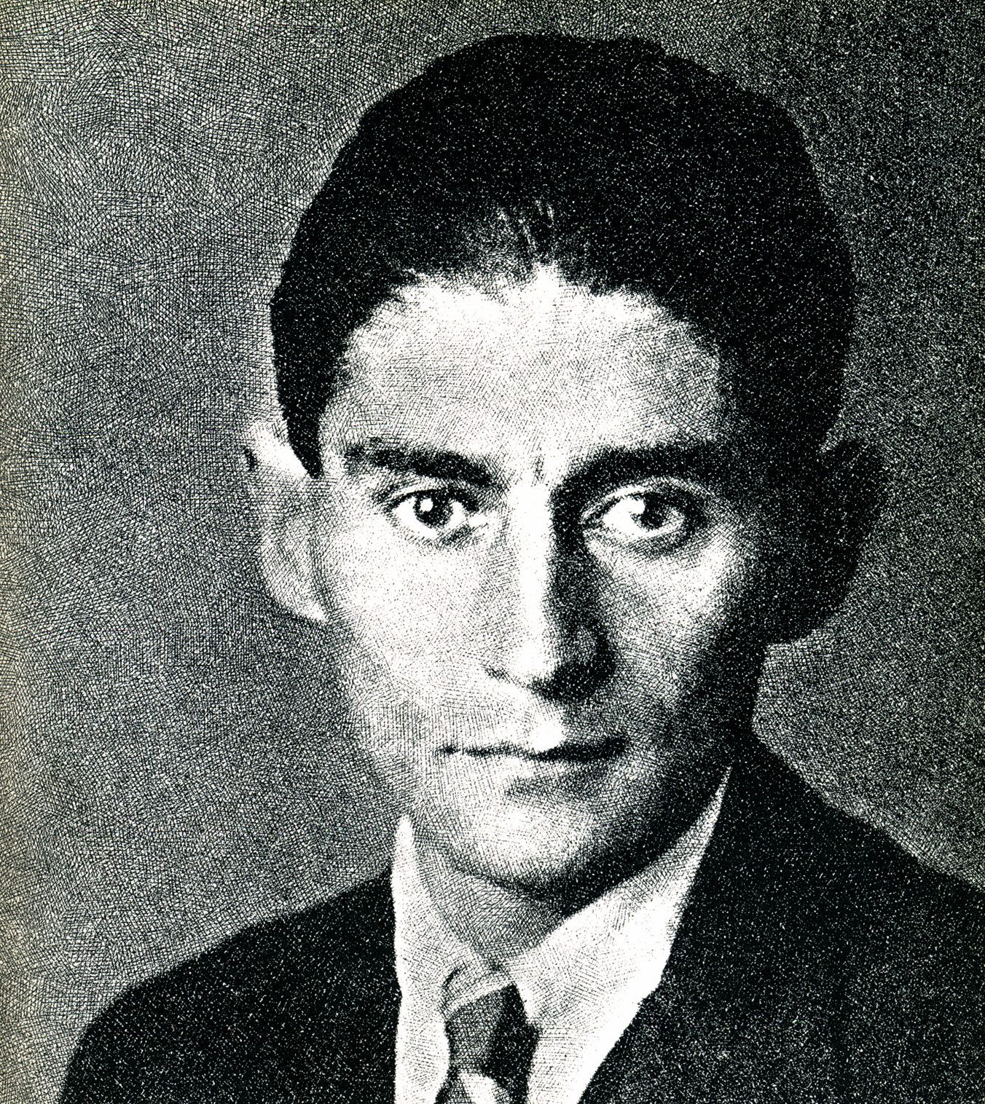
Why do streaming?
You have to glue all these systems together
Throughput as good as batch
Latency much better
Metaphor more natural for low latency than Hadoop

Slide 30
What makes successful infrastructure systems?
Operability and Operations
Monitoring
Simplicity
Documentation
Broad adoption
Lazy users
Open source

Slide 31
Open Source
Data > Infrastructure
Open source creates better code—even with few outside contributors
Commercial infrastructure not interesting

Slide 32
Open Source Projects
We made
  Voldemort: Key/Value storage
  Sensei, Bobo, Zoie: Elastic, faceted, real-time search with Lucene
  Kafka: Persistent, distributed data streams
  Norbert: Cluster aware RPC, load balancing, and group membership
  And others…
We stole
  Hadoop, Pig, Hive
  Lucene
  Netty, Jetty
  Zookeeper
  Avro
  Apache Traffic Server

Slide 33
The End
jay.kreps@gmail.com
http://www.linkedin.com/in/jaykreps
http://twitter.com/jaykreps
http://sna-projects.com

